Slide 1
Andrew Cowan-Nagora NY Uber Pickups Case Study

Slide 2
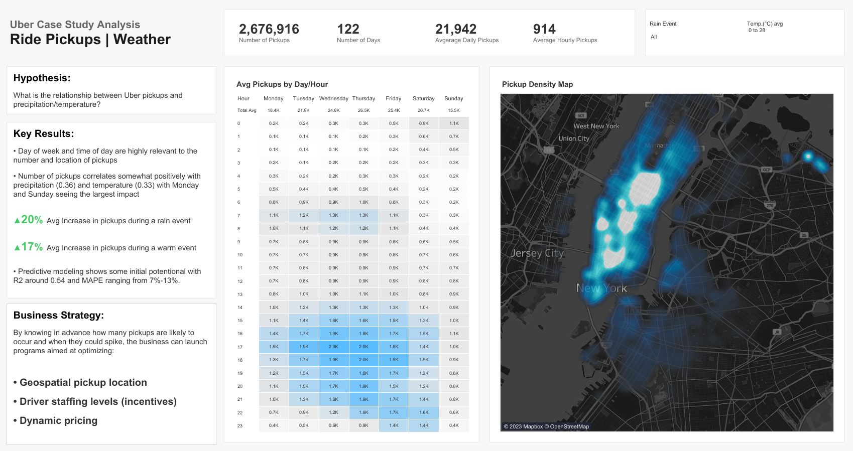

Slide 3
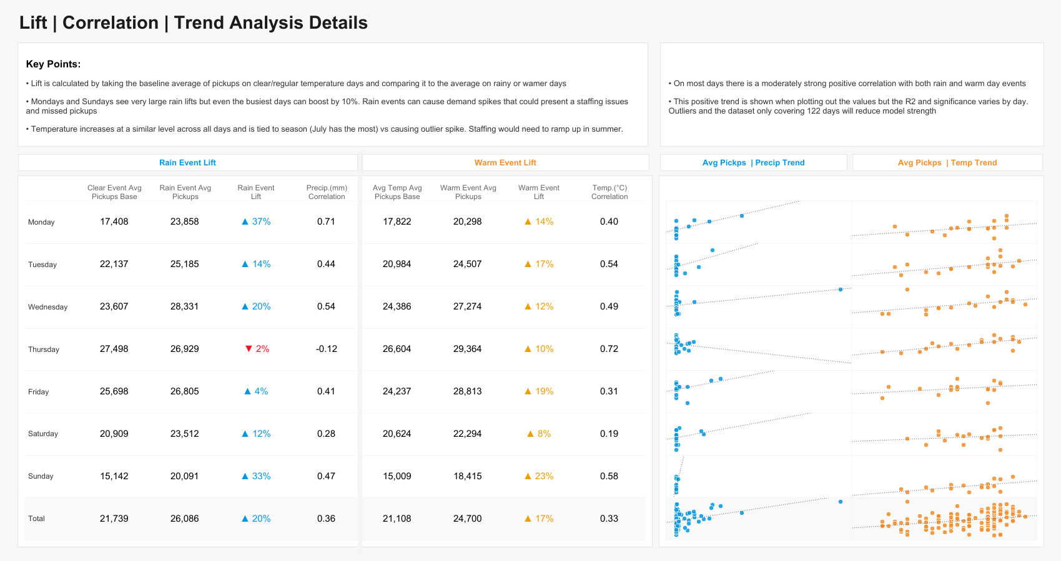

Slide 4
